Slide 1

University Information
Recording System
Record yourself start from now
Dream your dream in the future

Slide 2
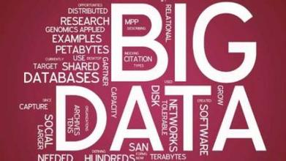
Everyday, there will be lot of data around us, if you collect them and keep them, they'll benefit you.
However, if you waste them and / or collect them in a wrong way, it will be big rubbish ---- Famous Chinese magazine Programmer 2013
We are preparing each of you an account. Let's go!

Slide 3
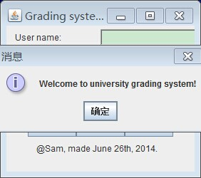
Landing Surface

Slide 4
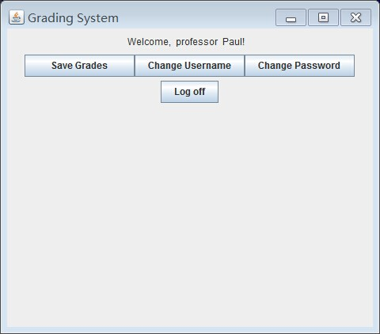
User Surface

Slide 5
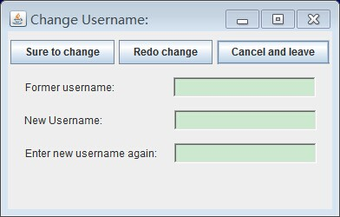
Information Surface

Slide 6
However, then problem comes
Some fuctions are not able to be implemented.
Plan to have a table here to show the students' grades and let professors change them. But nothing. And the "Save Grade" button doesn't work.

Slide 7
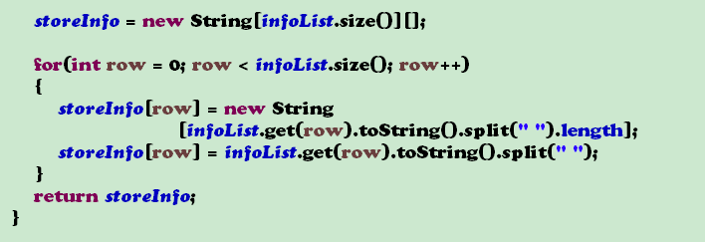
The way to get and store information is still silly.

Slide 8
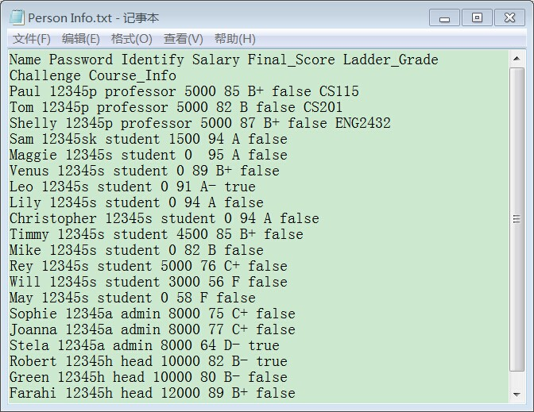
Database is
DANGEROUS!!

Slide 9
Improving Targets:
1.Get the technology to encapsulate the database.
2.Able to own more functions (get grades of students and professors, get courses they take, get jobs they should do and their deadlines, the projects they are doing and similar projects they may interested in....)
3. Predict their future jobs according to the data got from them.
4. Able to register and remove students, professors, faculties from the system.

Slide 10
Key things we want to learn
1.How to cooperate with others in a big project.
2.How to divide our jobs when meeting a big project.
3.More fancy technologies. And of course, PRACTICE DATA STRUCTURE KNOWLEDGE WE LEARNT.

Slide 11
三克油买来买去！
Sam
Christine
Leila
Leon
Matthew
Vincent
Miner

